Slide 1
Python Presentation
Sikander (22)
Khairul Amri (06)
Low Yao Xian (01)

Slide 2
Objectives
Best Cyber Pte Ltd has just clinched a deal from an important client ABWeb Pte Ltd. The project is to create an application to perform penetration testing on their website to determine vulnerability.
ABWeb believes that Python is one of the most appropriate programming languages for to be used for pen-testing. ABWeb is expecting to use Python to create script(s) to perform the first two step of pen-testing namely reconnaissance and mapping.
Our group has been tasked to work with two other cyber-security specialists to develop a script to perform the task. The script includes test cases, results and technical documentation for this project.

Slide 3
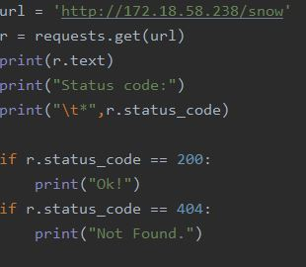

Performing a “GET” request on the website
Script:
The address that we are performing a “GET” request is “http://172.18.58.238/snow”
For the following script to run, we have to install a project interpreter which is requests
The following script that we typed, outputs a status from the header. Thus, it returns a status code which informs us that it was successful.
Result:
Notes:
An HTTP command used to request a file from a Web server

Slide 4
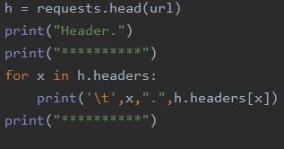
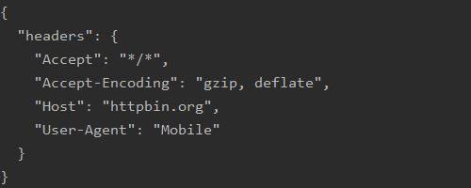
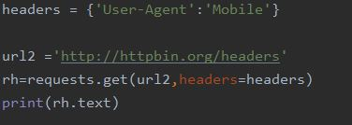
Displaying and modifying the User-Agent
We want the header response from the server. We modified the script to change the “User-Agent” field to display “Mobile”. We then test it against the website to output the results as follows.
In conclusion, the response headers give us the information needed.
This part display the website header
This part changes the user-header to be ‘Mobile’
Results

Slide 5
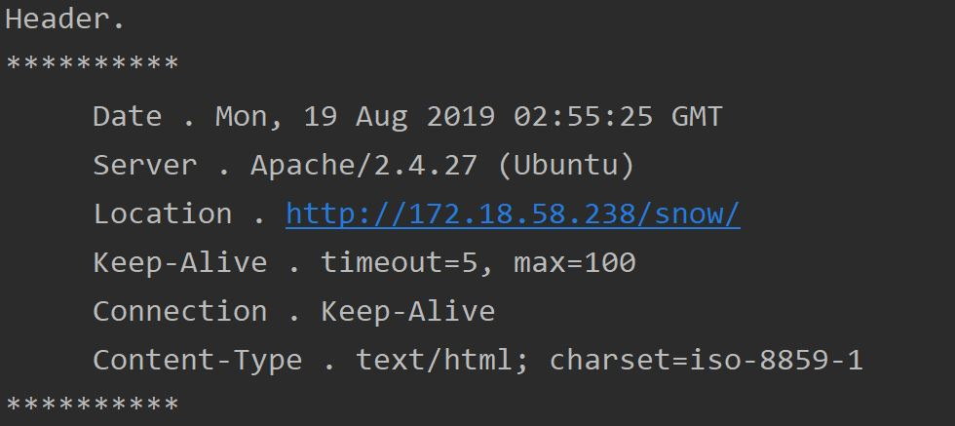
Displaying and modifying the Website header
We will now request for the website header in our script this few lines of code will request a header and we will be printing it out in a specific format as shown.
This part display the website header
This is the result, The header will be in this specific format

Slide 6
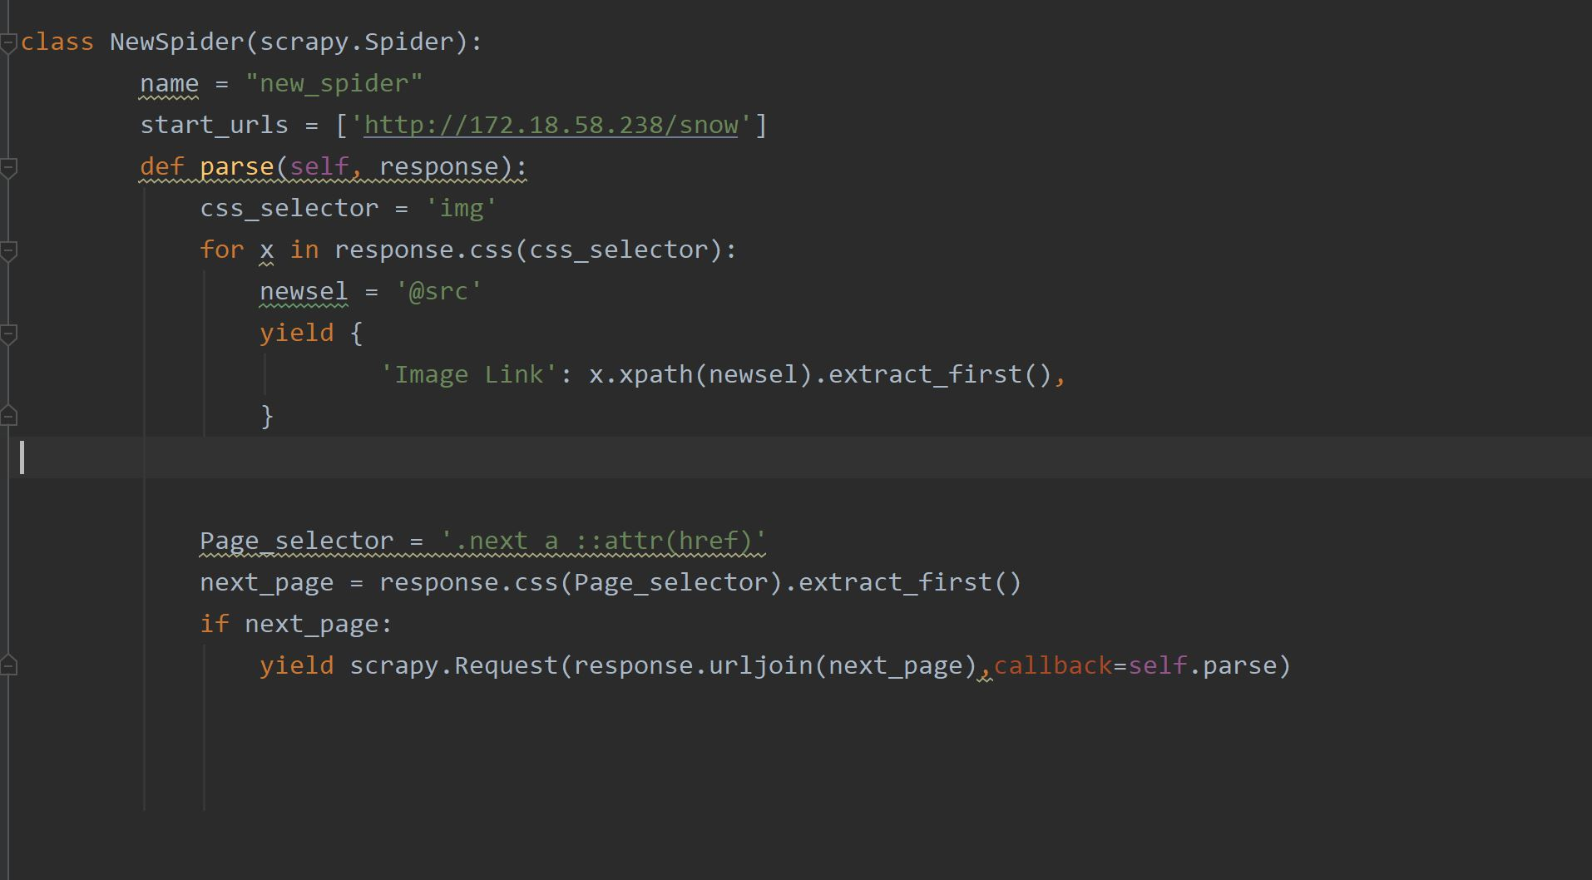
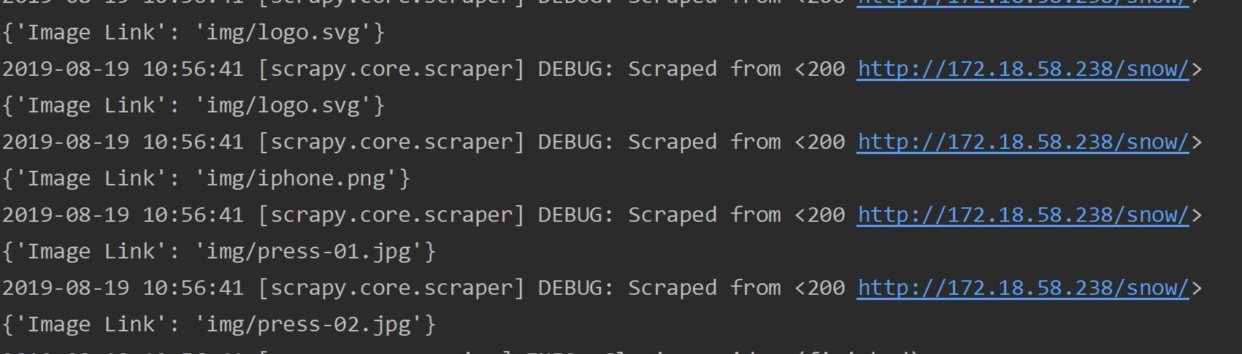
Performing mapping on the website
The Website where mapping will be performed is “http://172.18.58.238/snow”
Firstly, we installed the project interpreter Scrapy. By installing Scrapy, we are extracting information from the web for analysis. The information that we extracted will then be stored in a .JSON file.
Information extracted and referenced webpage
Notes:
To be said in the presentation
The start_urls is where the ‘spider’ will begin to crawl with the url provided.
parse(self,response) the function will be called whenever a URL is crawled successfully. Also called a callback function. The response used in scrapy shell returned as a result of crawling is passed in this function.

Slide 7
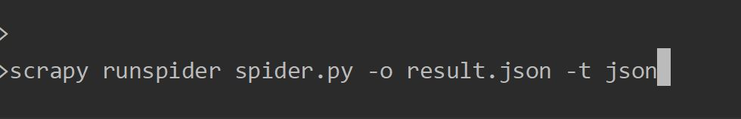
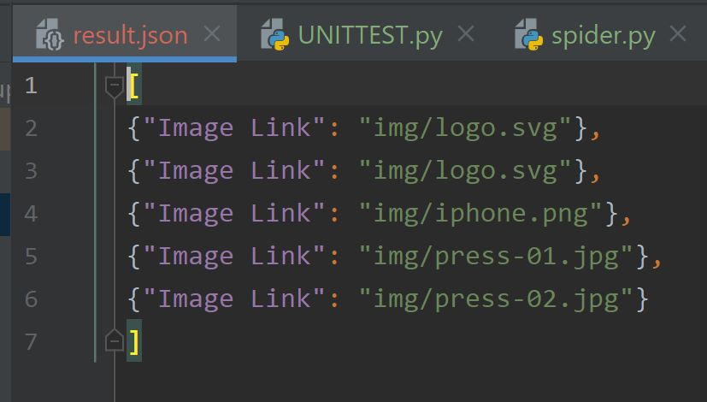
Extracting the image link to a file
So this is where we extract the image link of our website by using a specific command that will create a new file and will store the image link inside the specific file
This is the command that will create a json file and extract the links inside it
This will be the result, a new file will be created named “results.json” inside will be all the image link

Slide 8
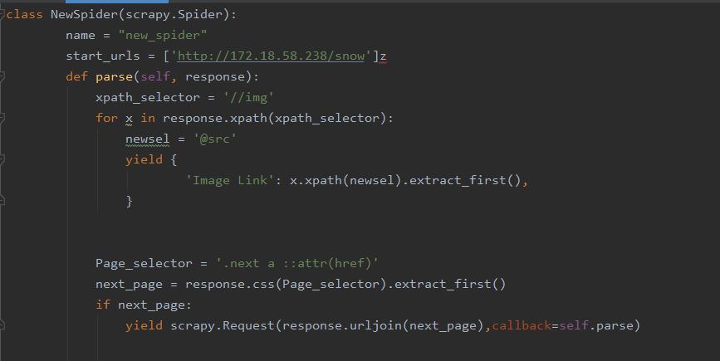
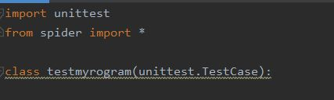

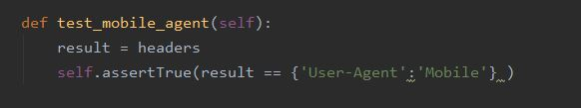
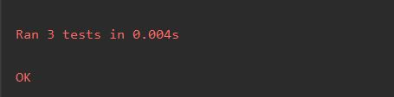
Unit Testing
This is where we import the functions in the script from our spider.py
Now we made a Unit Testing script to test our different function in the main script at the same time, than testing its individually which is more tedious
This is where we test the “status code” function
This code is where we test the function for the “User-Agent”

Slide 9
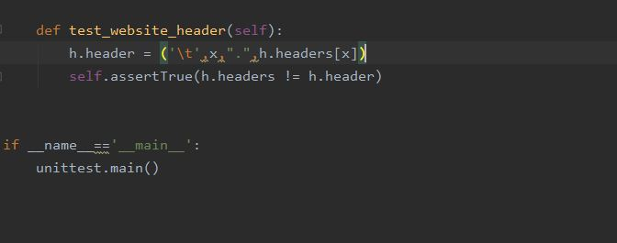
Unit Testing
And finally this is where we test the function of the website header
All of the 3 test will run at the same time and if the all of the pass it will show and ‘OK’ as follows

Slide 10
Conclusion
Throughout the course of this project, we learnt to use the command line tools and Integrated Development Environment (IDE) to perform the relevant tasks. Also, we learnt to use variables, list and data correctly to meet the program requirements.

